Slide 1

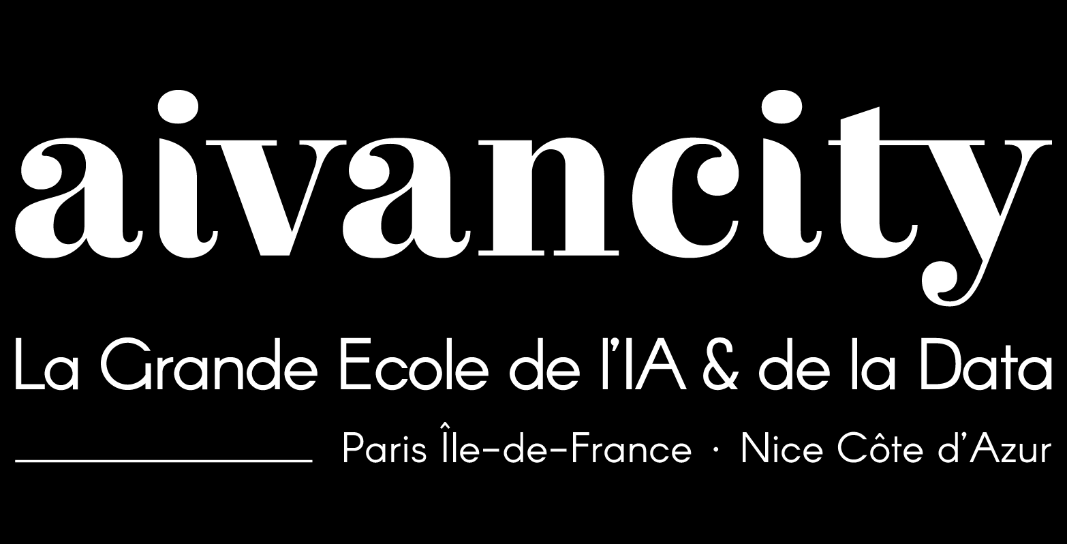

Future of AI
28/10/2025
Evolution of AI, Hype vs Reality, key paradigms

Slide 2

Course plan
Road to future of AI: Evolution of AI, Research frontiers, Hype vs Reality, Key paradigms.
AI super intelligence & consciousness/sentience.
Generative AI for creativity: multimodal generation, creative industries, risks and biases
AI in education & society
﻿﻿AI in science & industry: material science, protein folding
Future computing paradigms
Quantum Machine Learning
October 2025 |

Slide 3
What we will cover
Neural networks
Supervised & self-supervised learning
Representation & unsupervised learning
Reinforcement learning
Generative AI
World models
Energy based models
Quantum computing
Putting everything together with lots of applications
October 2025 |

Slide 4

Hello World !
Yasser KHALAFAOUI, Ph.D.
Generative AI Researcher
@ Kompanion
khalafaoui@aivancity.ai
It’s me!
October 2025 |

Slide 5


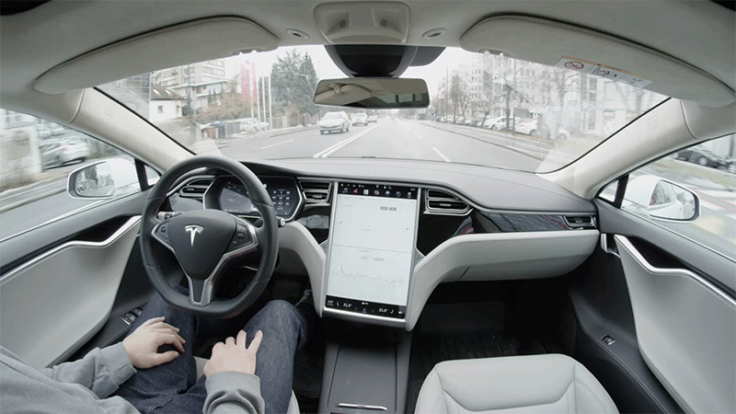
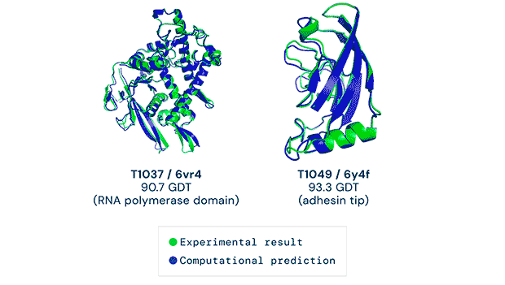
October 2025 |

Slide 6




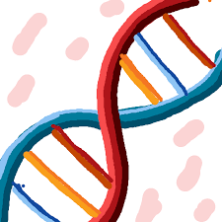
October 2025 |
Notes:
- Talk about how babies learn in real world: parents, dna, social norms, teacher - evoke parents and teacher as supervised learning: putting an ordered world for us
- Evoke interaction with world as an optimization of some objective and link it to reinforcement learning

Slide 7
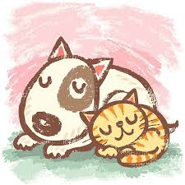


Meaning is defined by the company it keeps
October 2025 |
Notes:
Relational context is what helps you understand what a dog is

Slide 8

Meaning is relational
October 2025 |
Notes:
And with correlations and contrasting, you internally learn what cats are
Language is learned this way as the label or name dog would be associated with the understanding of dog we have. Parents only give the label and the child generalizes to all dogs
Talk about relation between dogs and mice which is ambiguous because we didn’t internally have one necessarily. And this forms the basis of what we consider normal and what is suprising (cat playing with mice) and (dog playing with mice)

Slide 9


Makes sense
Surprising
<< Human holding an umbrella >>
<< Dog holding an umbrella >>
October 2025 |
Notes:
- When relation is not clear, the model makes errors

Slide 10
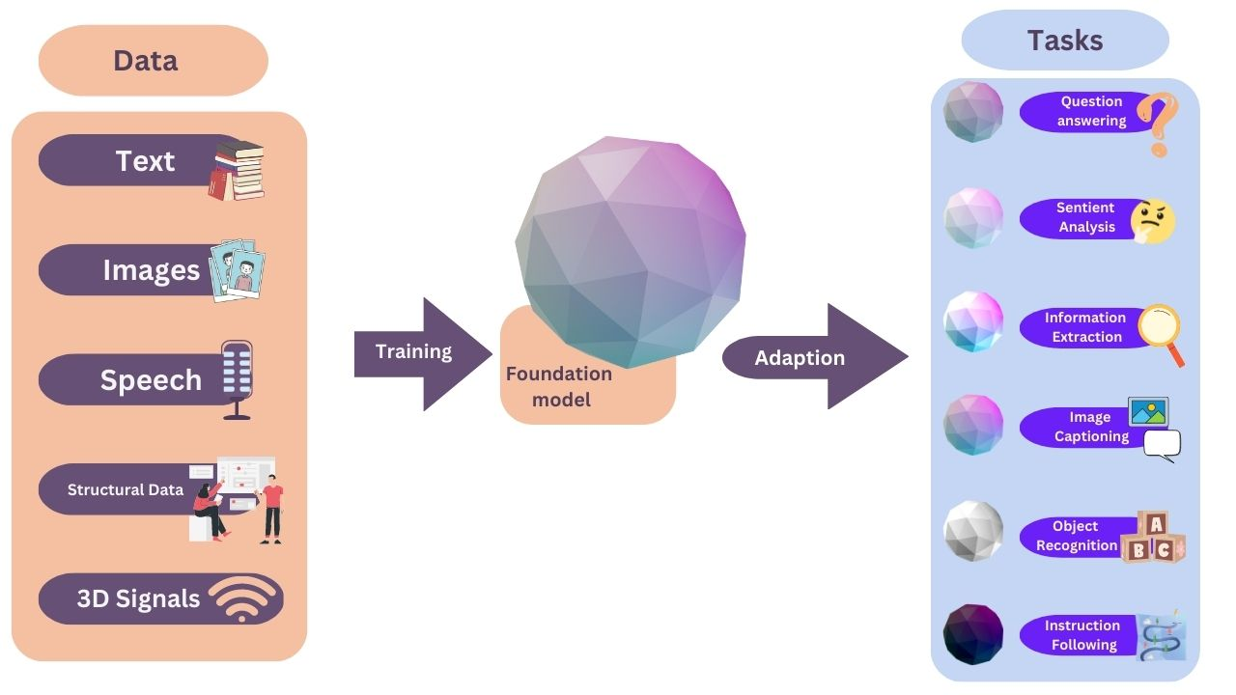
More relations = Better understanding
October 2025 |
Notes:
- Which brings us to the following -> more relations better understanding and it’s the core of foundation models

Slide 11
Why did it take so long?
October 2025 |
Notes:
- Ask students

Slide 12
Why did it take so long?
Learning vs Designing
Chaos vs Order
Top-down vs Bottom-up
October 2025 |
Notes:
Learning is flexible and intuitive while designing is having pieces and putting them together
Order (talk about atoms, galaxies) and chaos

Slide 13
Why aren’t we better at finding order & math?
In a bottom-up world of chaos, math is not that useful.
Instead intuition, flexibility and speed are useful
October 2025 |
Notes:
Talk about golden era of design and its link to top-down approach and we were successful by going to the moon, industrial revolution drug discovery etc….
Mention how the world is chaotic and why. Give examples on why these slides using symbolic AI, expert systems and how maths fails by oversimplifying complex and chaotic systems.

Slide 14
What instruments can learn from chaos?
Human brain
Neural networks
October 2025 |

Slide 15
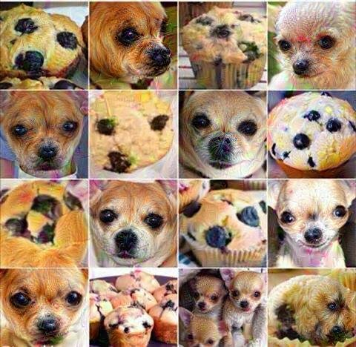
But how do we make it learn from chaos?
Isolating and structuring the world (supervised learning), but:
Scales with labels
Limited by human experts
Can everything be labeled?
Doesn’t generalize
Learning guided by ultimate goals (reinforcement learning), but:
Feedback might be long before optimizing
As a blank slate, where do you start
Dog or Muffin?
October 2025 |
Notes:
For reinforcement learning, talk about a human optimizing for hunger by picking the wrong things to focus on as well as a car learning to get us home and we might hit a million persons before reaching home and learning from the experience

Slide 16
We need a basic model of the world achieved by just observing it
October 2025 |

Slide 17
Meaning is defined by the company it keeps
October 2025 |
Notes:
Breakthrough is self-supervised learning

Slide 18
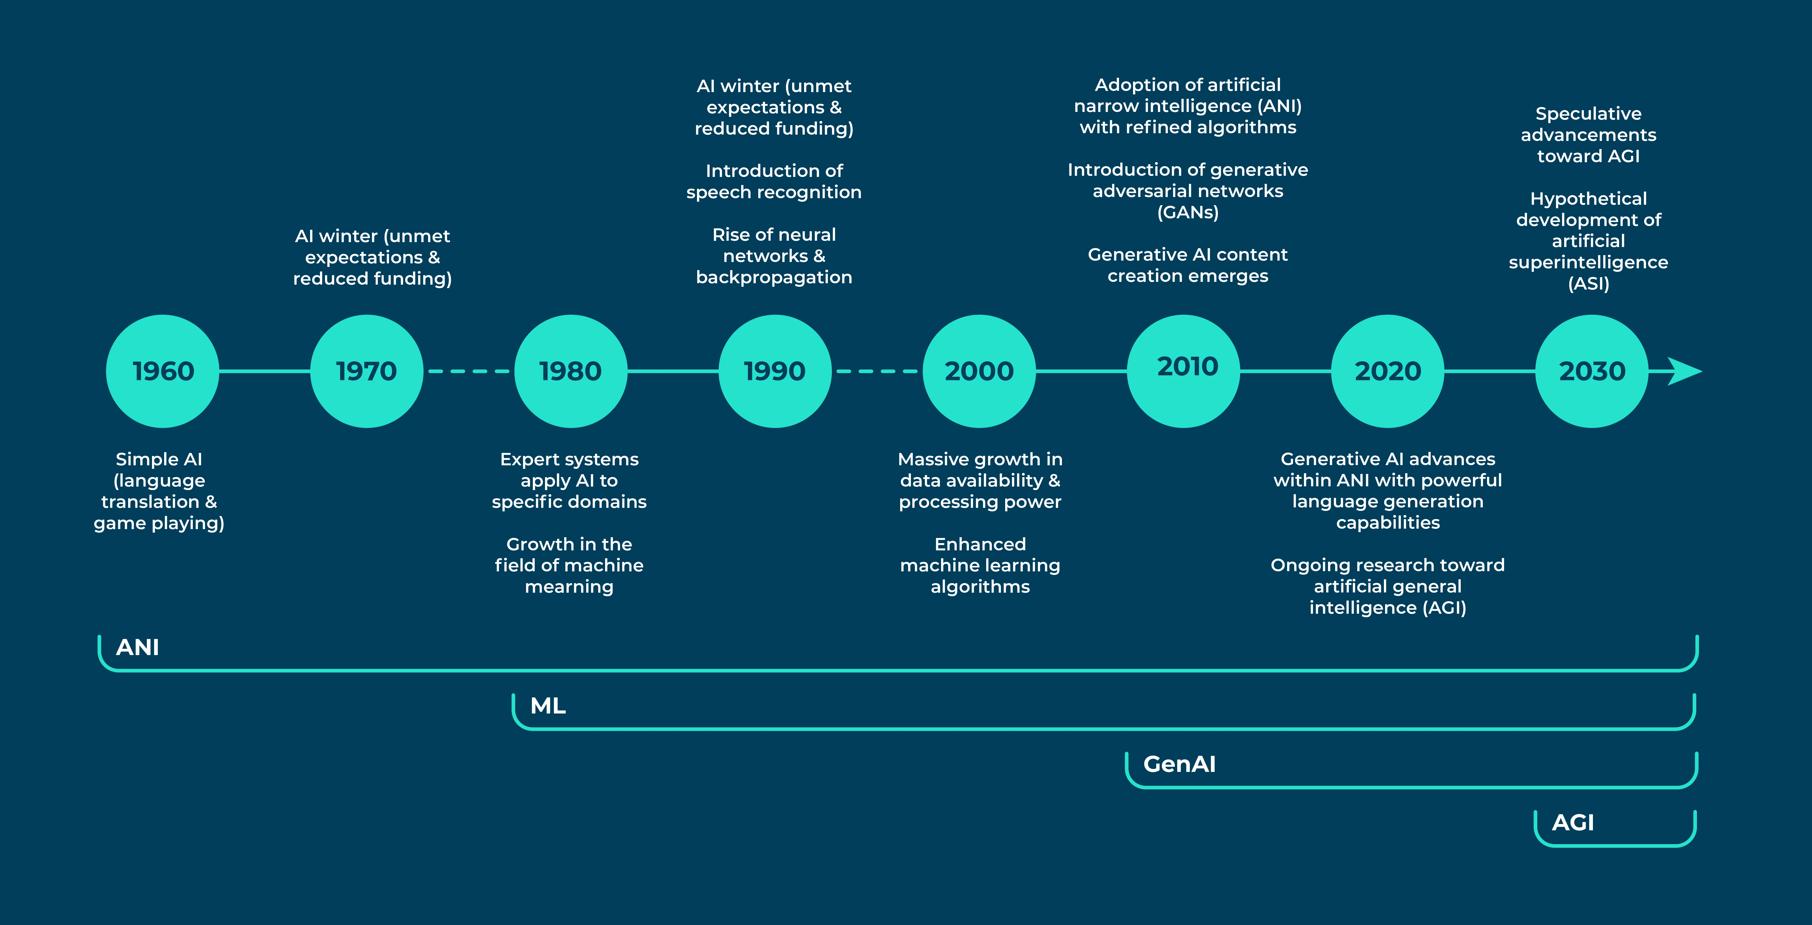
October 2025 |
Notes:
Extract information from this source https://www.concentrix.com/insights/blog/a-guide-to-the-evolution-of-ai/

Slide 19
AI, hype or reality?
October 2025 |

Slide 20
Problem with AI-First thinking
Misunderstanding AI capabilities
Overlooking Simpler Solutions
Neglecting ethical considerations
October 2025 |

Slide 21
Shifting focus from AI to Problem-Solving
Start with the “why” – identify pain points and opportunities
Explore all options – Don’t limit yourself to AI solutions.
Prioritize human-centered design – Focus on the employees and customers needs and experiences.
October 2025 |

Slide 22
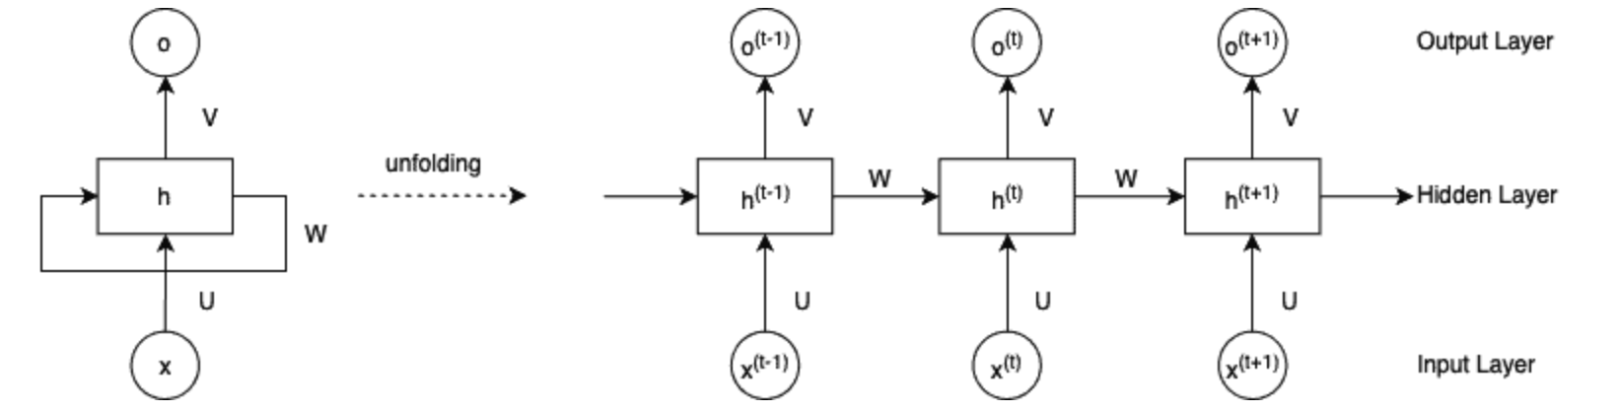
What is RNN?
RNNs are a class of neural networks which are able to handle sequential data by incorporating information from previous inputs.
This architecture contains a hidden state, which allows them to retain information from previous time steps. They operate on sequential data by processing one input at a time, updating their hidden state based on the current and previous hidden states.
RNNs are particularly effective in capturing short-term dependencies in sequences. However, they suffer from the vanishing gradient problem.
October 2025 |
Notes:
Explain formula of RNN

Slide 23
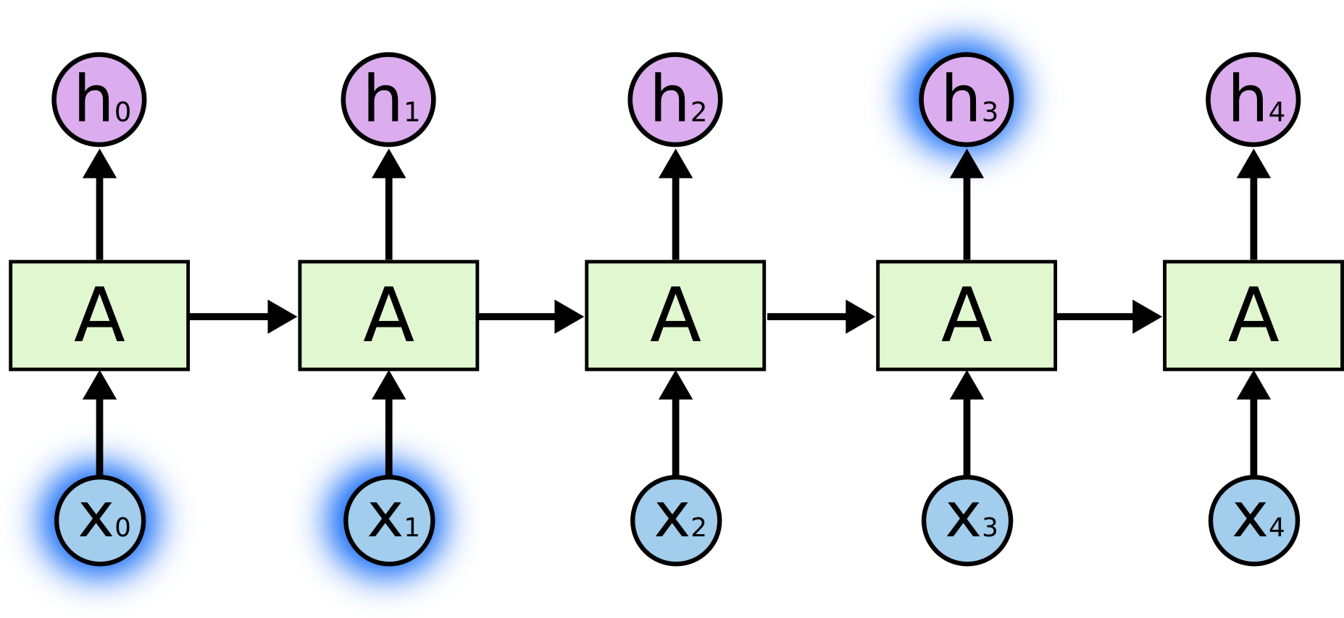
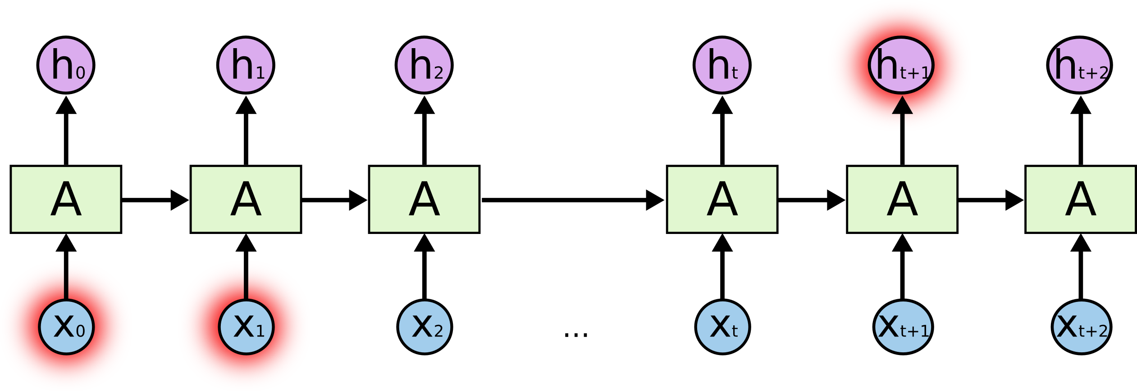
The problem of Long-Term Dependencies
Sometimes, we only need to look at recent information to perform the present task. For example, a language model trying to predict the next word in “the clouds are in the ….”.
But there are also cases where we need more context. For example trying to predict the last word in the text “I grew up in France…… I speak fluent …”. Here we need the context of France from further back to predict French.
Unfortunately, as the gap grows, RNNs become unable to learn to connect the information.
October 2025 |
Notes:
In such cases, where the gap between the relevant information and the place that it’s needed is small, RNNs can learn to use the past information.

Slide 24

LSTM networks
Long Short Term Memory networks – usually just called “LSTMs” – are a special kind of RNN, capable of learning long-term dependencies.
LSTMs are explicitly designed to avoid the long-term dependency problem. Remembering information for long periods of time is practically their default behavior, not something they struggle to learn!
Instead of having a single neural network layer, there are four, interacting in a very special way.
October 2025 |
Notes:
Explain formula of RNN

Slide 25
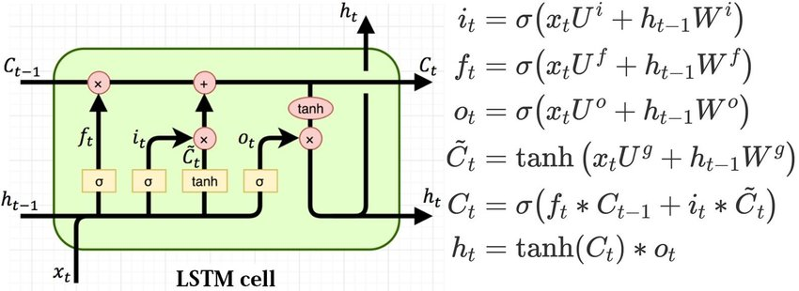
Core Idea behing LSTMs
The key to LSTMs is the cell state, the horizontal line running through the top of the diagram.
The LSTM does have the ability to remove or add information to the cell state, carefully regulated by structures called gates.
October 2025 |
Notes:
Explain formula of RNN

Slide 26
Drawbacks to LSTMs
Take longer to train
Require more memory to train
Easy to overfit
Dropout is much harder to implement
Sensitive to different random weight initializations
October 2025 |
Notes:
Explain formula of RNN

Slide 27
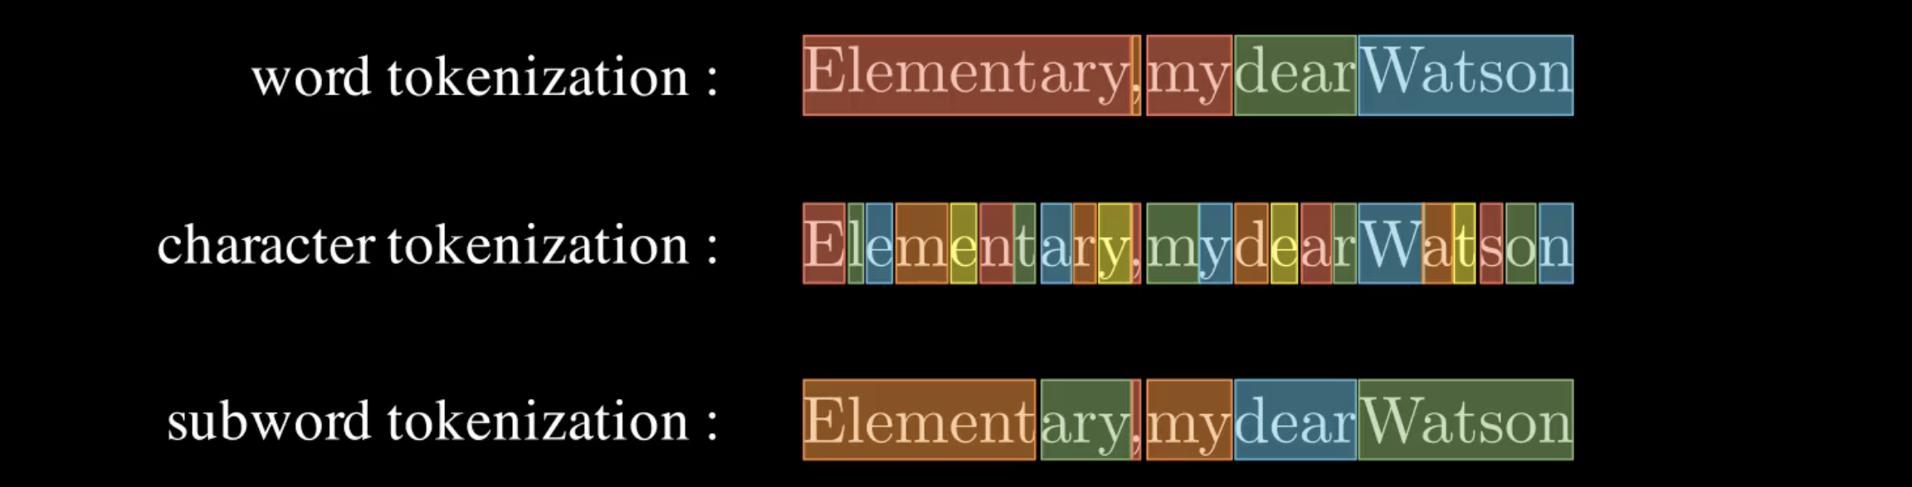
Tokenization
Word Tokenization - The text is split into individual words.
Character Tokenization - The text is split into individual characters.
Subword Tokenization - The text is split into partial words or character sets. This method is commonly used in OpenAI’s GPT models via Byte-Pair Encoding (BPE).
October 2025 |

Slide 28
Embeddings
Word embeddings - Once a sentence is tokenized, each token is transformed into a vector of floating-point numbers — known as an embedding. These embeddings allow the machine to capture the meaning and relationships between words.
Contextual embeddings - Language is contextual — words can change their meaning depending on the surrounding words. Transformer models take this into account by adjusting the embedding of a word based on the context in which it appears.
October 2025 |

Slide 29
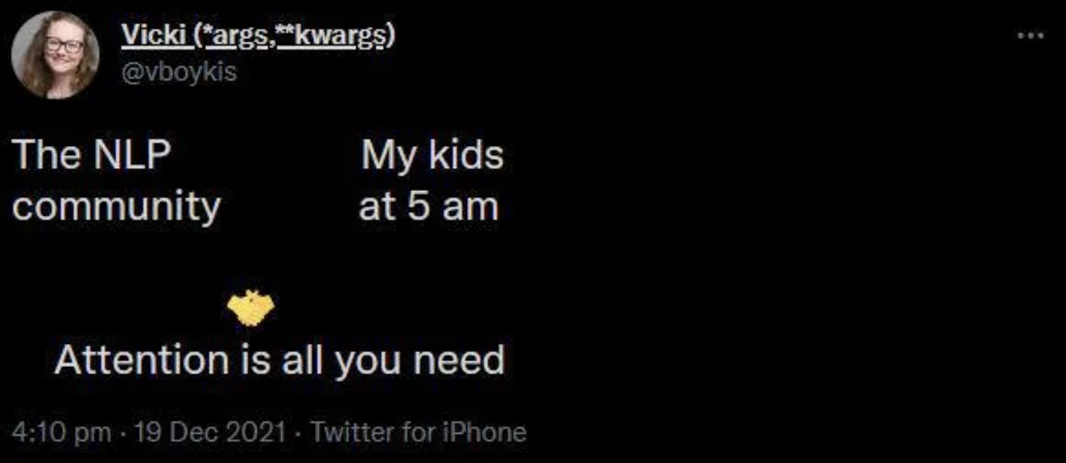
Attention mechanism
October 2025 |

Slide 30
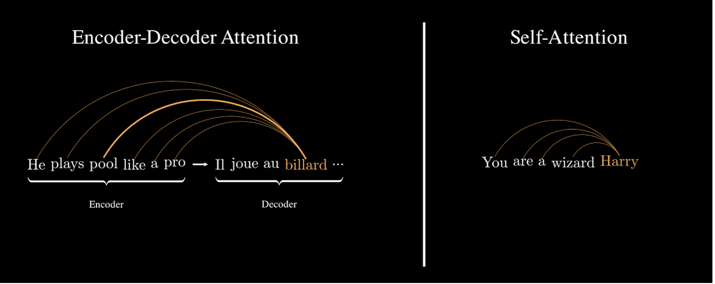
Attention mechanism
The attention mechanism was originally introduced by Dzmitry Bahdanau and colleagues[1] to enhance sequence-to-sequence models. Its purpose was to allow the decoder to focus on specific parts of the input sequence—encoded by the encoder—at each step.
Self-attention operates similarly to the encoder-decoder attention, but with one key difference: instead of focusing on an external sequence, each word in a sentence attends to every other word in the same sentence. This allows the model to build rich contextual representations of each word, accounting for its relationships with all other words in the sequence.
[1] Neural machine translation by jointly learning to align and translate D. Bahdanau. arXiv preprint arXiv:1409.0473. 2014.
October 2025 |
Notes:
For reinforcement learning, talk about a human optimizing for hunger by picking the wrong things to focus on as well as a car learning to get us home and we might hit a million persons before reaching home and learning from the experience

Slide 31
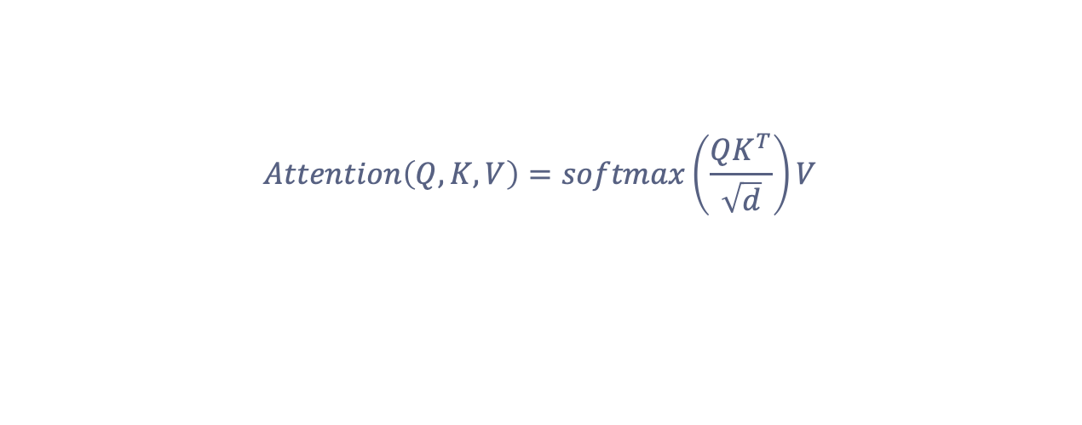
Scaled Dot-Product Attention mechanism
$$Attention\left(Q, K, V\right)=softmax\left(\frac{QK^{T}}{\sqrt{d}}\right)V$$
October 2025 |
Notes:
For reinforcement learning, talk about a human optimizing for hunger by picking the wrong things to focus on as well as a car learning to get us home and we might hit a million persons before reaching home and learning from the experience

Slide 32
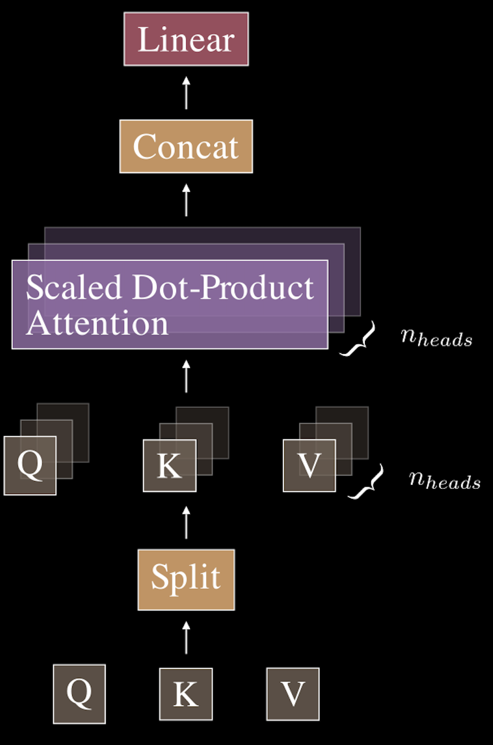
Multi-head Attention mechanism
Multi-head attention is an extension of the scaled dot-product attention mechanism.
Rather than having just one set of attention weights and outputs, multi-head attention allows the model to use multiple attention mechanisms (or “heads”) in parallel. Each head operates independently and captures different aspects of the input sequence.
[1] Neural machine translation by jointly learning to align and translate D. Bahdanau. arXiv preprint arXiv:1409.0473. 2014.
October 2025 |
Notes:
For reinforcement learning, talk about a human optimizing for hunger by picking the wrong things to focus on as well as a car learning to get us home and we might hit a million persons before reaching home and learning from the experience

Slide 33
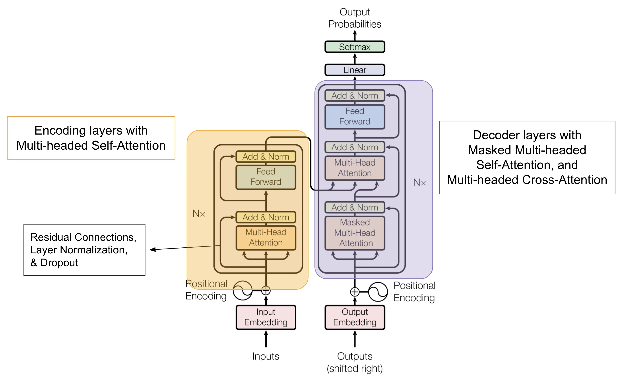
Transformer architecture
October 2025 |
Notes:
For reinforcement learning, talk about a human optimizing for hunger by picking the wrong things to focus on as well as a car learning to get us home and we might hit a million persons before reaching home and learning from the experience

Slide 34
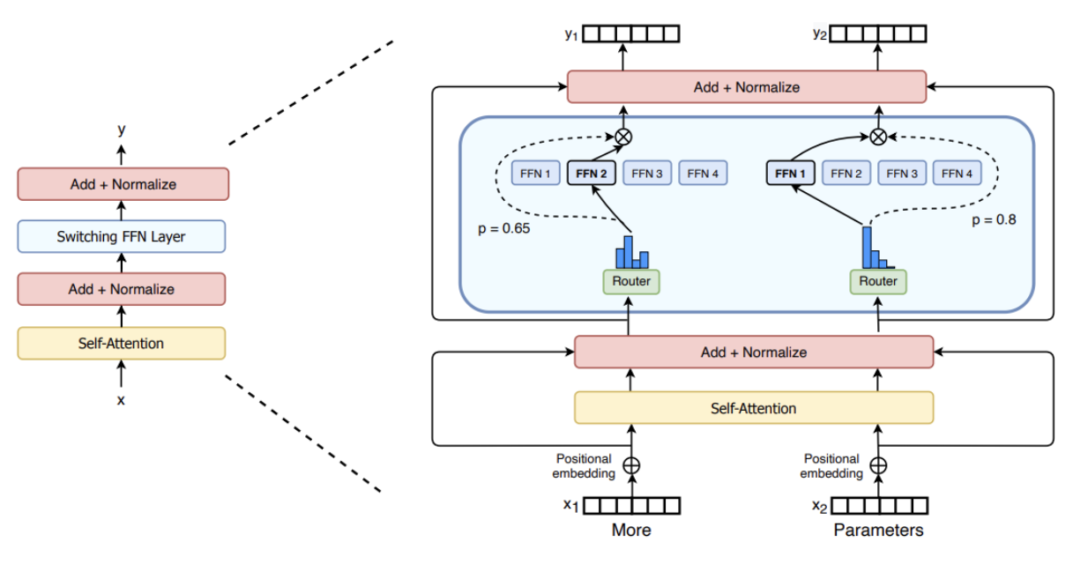
What is a Mixture of Experts (MoE)?
Mixture of Experts enable models to be pretrained with far less compute, which means you can dramatically scale up the model or dataset size with the same compute budget as a dense model.
A MoE consists of two main elements:
Sparse MoE layers are used instead of dense feed-forward network (FFN) layers.
A gate network or router, that determines which tokens are sent to which expert.
October 2025 |
Notes:
For reinforcement learning, talk about a human optimizing for hunger by picking the wrong things to focus on as well as a car learning to get us home and we might hit a million persons before reaching home and learning from the experience

